Slide 1
DevOps Essentials

Slide 2
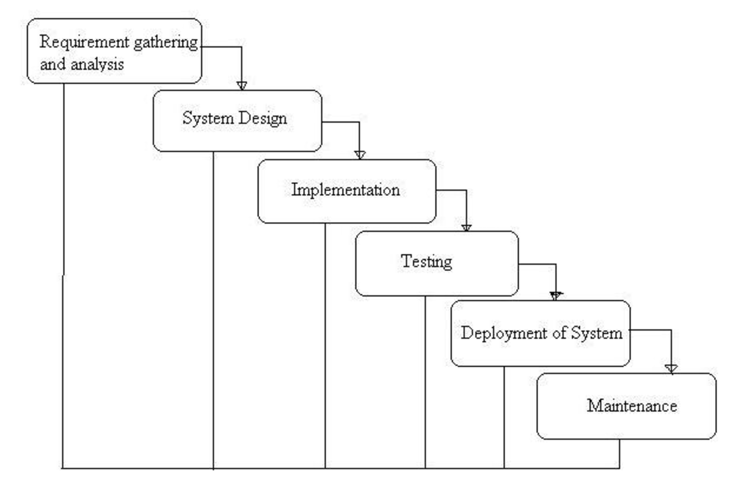
Traditional Development Models
Waterfall model:
Incorrect requirements
Development timelines
Late feedbacks

Slide 3
Agile
The Agile movement seeks alternatives to traditional project management. Agile approaches help teams respond to unpredictability through incremental, iterative work cadences and empirical feedback.

Slide 4
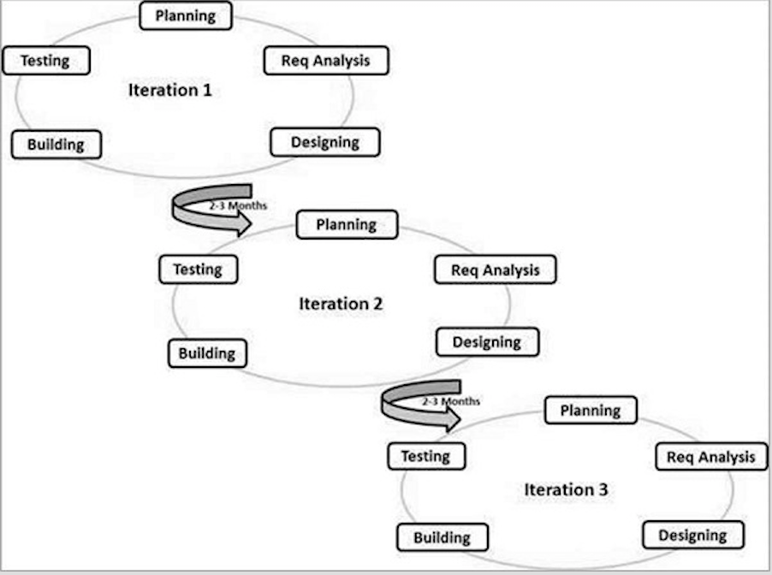
Agile work flow

Slide 5
DevOps
DevOps is a Software Development approach which involves Continuous Development, Continuous Testing, Continuous Integration, Continuous Deployment and Continuous Monitoring of the software throughout its development life cycle.

Slide 6
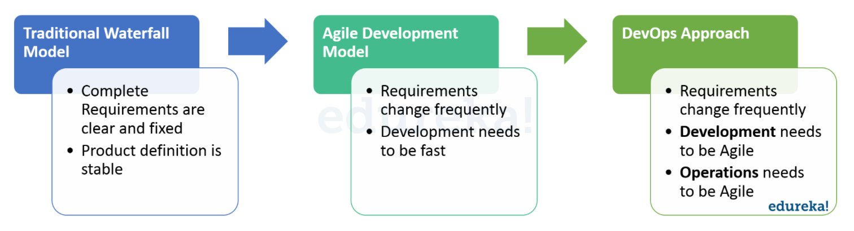
Evolution of DevOps

Slide 7
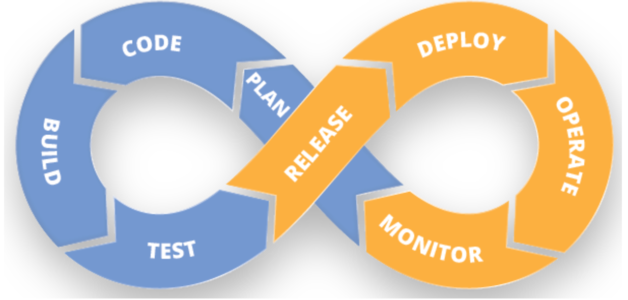
DevOps work flow

Slide 8
Continuous Development
This is the stage in the DevOps life cycle where the Software is developed continuously. Unlike the Waterfall model the software deliverables are broken down into multiple sprints of short development cycles, developed and then delivered in a very short time. This stage involves the Coding and Building phases and makes use of tools such as Git and SVN for maintaining the different versions of the code, and tools like Ant, Maven, Gradle for building / packaging the code into an executable file that can be forwarded to the QAs for testing.

Slide 9
Continuous Testing
It is the stage where the developed software is continuously tested for bugs. For Continuous testing testing automation tools like Selenium, JUnit etc are used. These tools enables the QA’s for testing multiple code-bases thoroughly in parallel to ensure that there are no flaws in the functionality. In this phase use of Docker containers for simulating testing environment on the fly, is also a preferred choice. Once the code is tested, it is continuously integrated with the existing code.

Slide 10
Continuous Integration
This is the stage where the code supporting new functionality is integrated with the existing code. Since there is continuous development of software, the updated code needs to be integrated continuously as well as smoothly with the systems to reflect changes to the end users. The changed code, should also ensure that there are no errors in the runtime environment, allowing us to test the changes and check how it reacts with other changes. Jenkins is a very popular tool used for Continuous Integration. Using Jenkins one can pull the latest code revision from GIT repository and produce a build which can finally be deployed to test or production server. It can be set to trigger a new build automatically as soon as there is change in the GIT repository or can be triggered manually on click of a button.

Slide 11
Continuous Deployment
It is the stage where the code is deployed to the production environment. Here we ensure that the code is correctly deployed on all the servers. If there is any addition of functionality or a new feature is introduced then one should be ready to welcome greater website traffic. So it is also the responsibility of the SysAdmin to scale up the servers to host more users. Since the new code is deployed on a continuous basis, automation tools play an important role for executing tasks quickly and frequently. Puppet, Chef, SaltStack and Ansible are some popular tools that are used in this stage.

Slide 12
Continuous Monitoring
This is a very crucial stage in the DevOps life cycle which is aimed at improving the quality of the software by monitoring its performance. This practice involves the participation of the Operations team who will monitor the user activity for bugs / any improper behavior of the system. This can also be achieved by making use of dedicated monitoring tools which will continuously monitor the application performance and highlight issues. Some popular tools used are Nagios, NewRelic and Sensu. These tools help you monitor the application and the servers closely to check the health of the system proactively. They can also improve productivity and increase the reliability of the systems, reducing IT support costs. Any major issues found could be reported to the Development team so that it can be fixed in the continuous development phase.

Slide 13
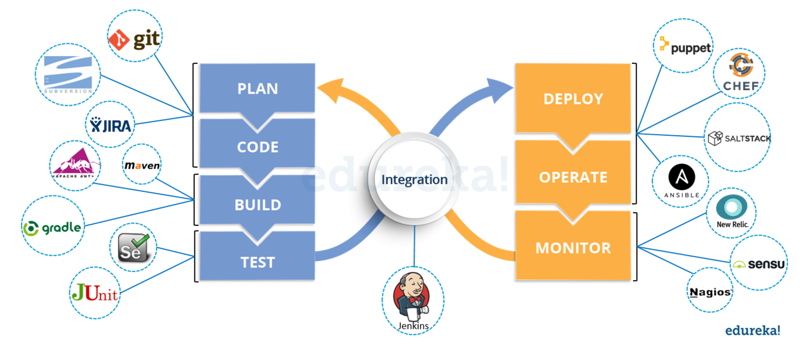
DevOps eco system

Slide 14
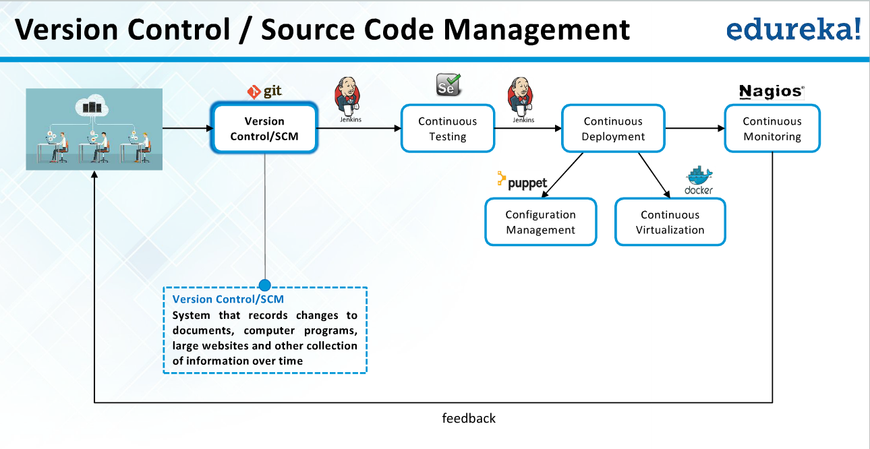
VCS/GIT

Slide 15
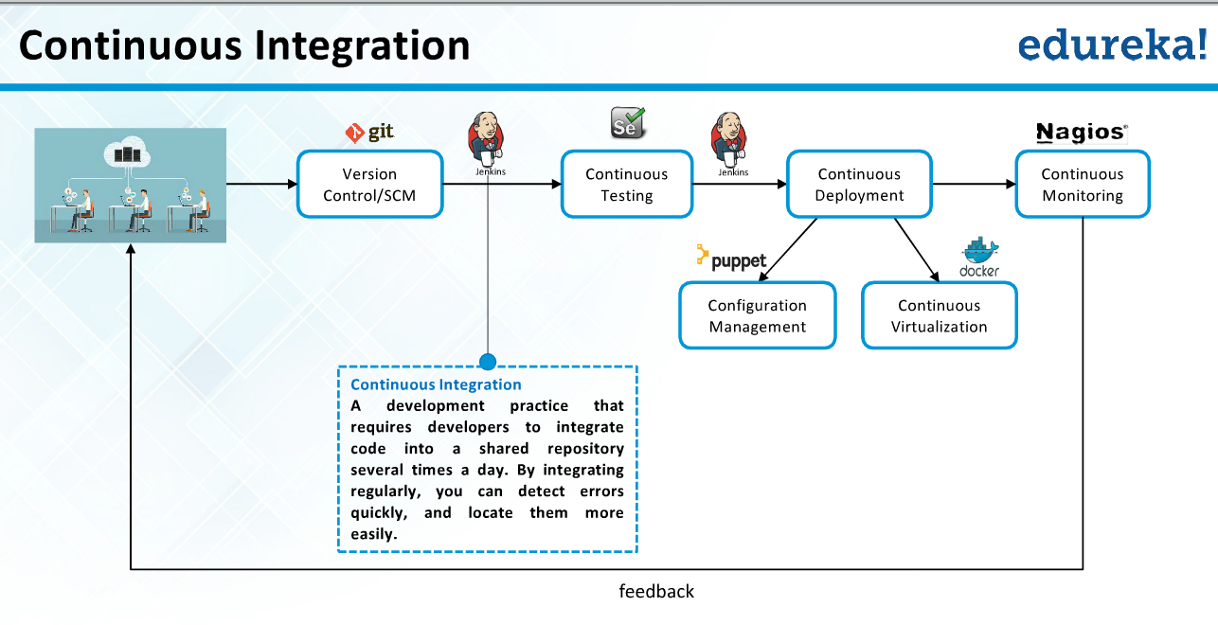
CI/Jenkins

Slide 16
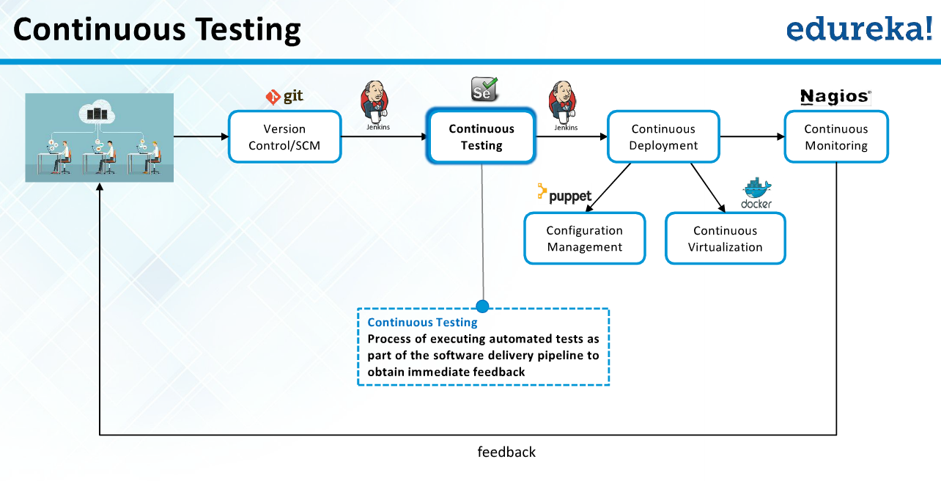
CT/Selenium

Slide 17
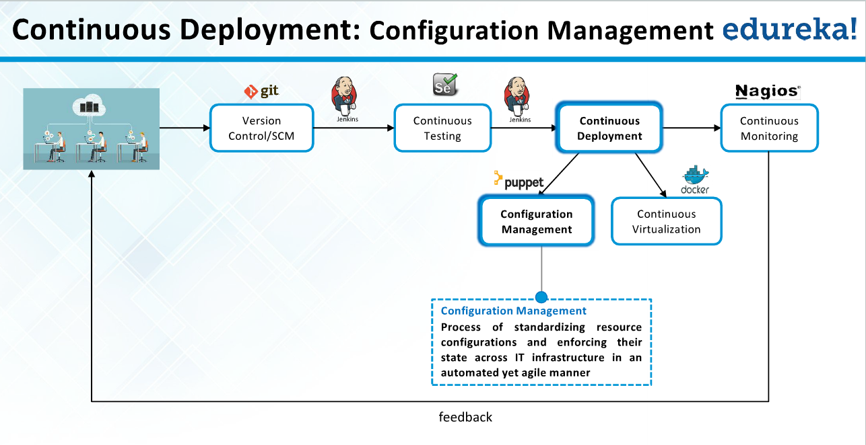
CD/Puppet

Slide 18
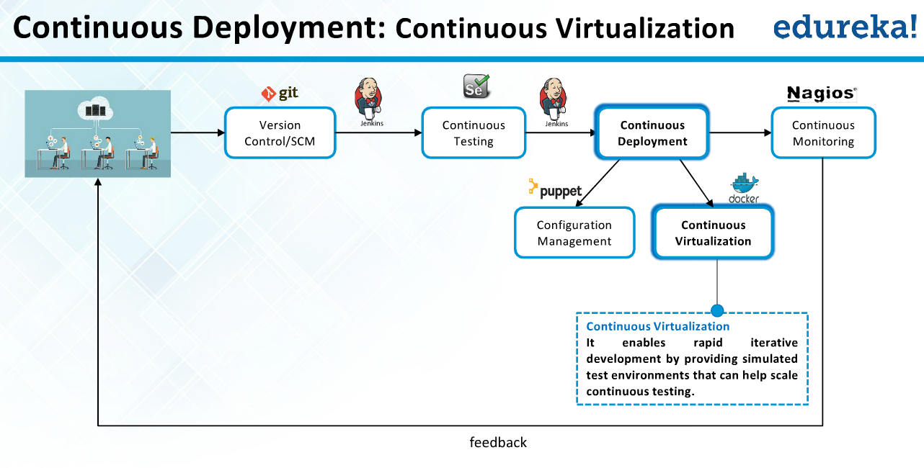
CD/Docker

Slide 19
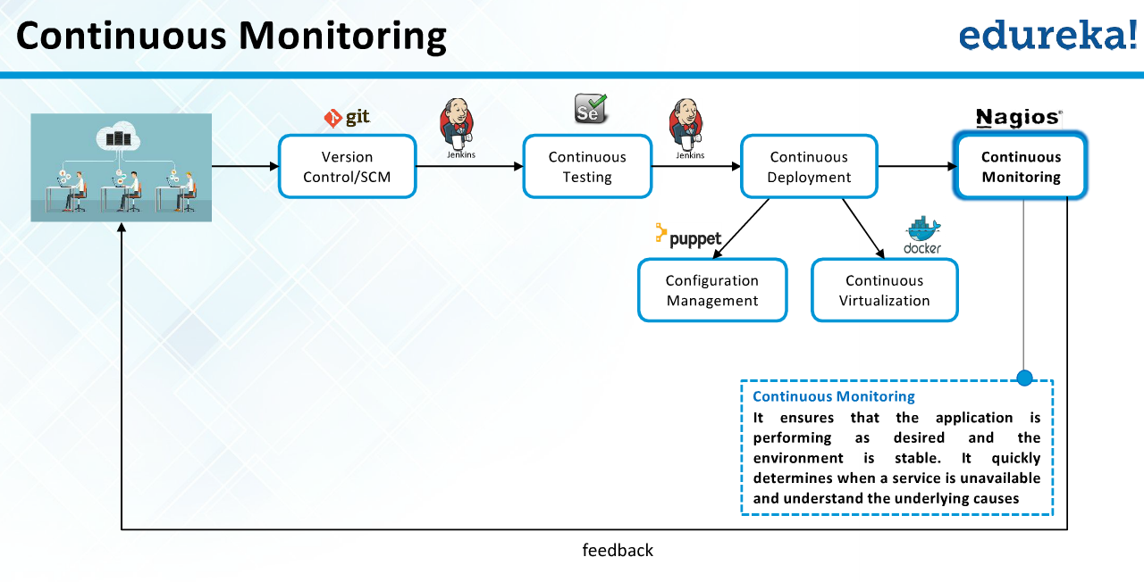
CM/Nagios

